Slide 1
Computational Geometry
(representation and manipulation)
Graham Rhodes
Senior Software Developer, Applied Research Associates, Inc.

Slide 2
Outline
Part 1: Explicit boundary representations
  Half edge data structure
  Editing geometry on the CPU
Part 2: Higher order surface modeling
  Subdivision surfaces using half edge data structure
  Higher order surfaces on the GPU

Slide 3
Part 1: Explicit Boundary Representations

Slide 4

Some Perspective
In-game models usually made of meshes
  Typically triangles
  Indexed triangle meshes
Vertex Coords
0 | <-.5, 0, 0>
1 | <0, 0, 0>
2 | <-.5, 0, .5>
3 | <0, 0, .5>
4 | <-.25, 0, 1>
5 | <-.5, 1, 0>
6 | <0, 1, 0>
7 | <-.5, 1, .5>
8 | <0, 1, .5>
9 | <-.25, 1, 1>
Triangles
0, 1, 2
1, 3, 2
2, 3, 4
1, 6, 3
3, 6, 8
3, 8, 9
3, 9, 4
…
4
9
8
2
3
6
0
1

Slide 5
Is a triangle mesh enough?
Good for rendering “fixed” geometry
Maybe not always
  Inconvenient for editing a mesh
  Inconvenient for subdivision modeling
  Inconvenient whenever the triangle connectivity (topology) needs to change
Notes:
By “fixed” I mean the topology is fixed. Model can be dynamic in that it moves either due to a changing overall transformation matrix or via some per-control vertex transformation such as skinned animation.

Slide 6
Data Structures for Editable Meshes
Manifold
  Winged Edge (Baumgart, 1972)
  Half Edge (presented here)
  Quad edge
Non-manifold
  Radial edge
  Generalized non-manifold
    (some game DCC tools, CAD, …)
Notes:
Generalized non-manifold is the type of data structure used in computer aided design software. It completely separates geometry and topology, and is much more rigorous that what we need to be concerned with for games. It is also far more difficult to implement. The complete division between geometry and topology makes this quite non-intuitive.
The open source modeling software, Blender, and other digital content creation tools used in the game industry, are based on non-manifold data topology structures.

Slide 7
Half Edge Data Structure (HEDS)
HE points to next half edge in traversal direction
Start point of HE.next is HE.endPt
struct HalfEdge
{
HalfEdgeVert *endPt;
HalfEdge *next;
};
HE.next
endPt
HE
Notes:
Note that for a close polygon, such as a triangle, we can find traverse the polygon’s boundary loop simply using HE.next recursively.

Slide 8
Half Edge Data Structure (HEDS)
HE may point to a face on its left side
All half edges in a loop point to same face
struct HalfEdge
{
HalfEdgeVert *endPt;
HalfEdge *next;
HalfEdgeFace *face;
};
Face
HE
Notes:
The truth is, the face is on the left side only depending on viewpoint. If we look at the half edge from a point-of-view where the loop is traversed in a counterclockwise fashion, the face is on the left of the edge….while walking along the edge we would turn towards the left to see the face. If we looked at this same object from behind, the face would appear to be on the right.

Slide 9
Half Edge Data Structure (HEDS)
HE points to its opposite half edge
Which is attributed as above
struct HalfEdge
{
HalfEdgeVert *endPt;
HalfEdge *next;
HalfEdgeFace *face;
HalfEdge *opposite;
};
opposite

Slide 10
Half Edge Data Structure (HEDS)
HE points to its opposite half edge
It can be useful to support custom data
struct HalfEdge
{
HalfEdgeVert *endPt;
HalfEdge *next;
HalfEdgeFace *face;
HalfEdge *opposite;
void *userData;
unsigned char marker;
};
opposite
Notes:
Note that due to the orientation flip of the opposite edge, the opposite face has the same orientation as the original half edge’s face. Orientation consistency is built into the data structure.

Slide 11
C++ half edge class definitions
struct HalfEdgeFace
{
HalfEdge *halfEdge;
unsigned char marker;
};
struct HalfEdge
{
HalfEdgeVert *endPt;
HalfEdge *next;
HalfEdge *opposite;
HalfEdgeFace *face;
void *userData;
unsigned char marker;
};
struct HalfEdgeVert
{
HalfEdge *halfEdge;
int index;
unsigned char marker;
};
Notes:
We are focusing on the half edge, but typical implementations also define special face and vertex data structures. These enable additional traversals that are useful.
The user data could be assigned to the edge, face, and/or vertex. It could store, for example, texture or UV mapping information.
The marker is useful to aid in traversals. For example, if you want to find he constellation of faces around a given starting face, then traverse around the face’s loop. For each vertex around the face, find the ring of faces around that vert, but skip any face that has a marker value of 1. For any as-yet-unmarked face, add it to your list, then set marker = 1 for that face. By using the marker in this way, it indicates that you’ve already visited a face and so it is already in your output list. You can also use this for Boolean type searches. For example, if you want to find faces connected to vert1, but not to vert2, first find the ring of faces around vert2, and set marker to 1. Then find the ring of faces around vert1, skipping any face with marker == 1. These are simple examples, but it should be clear that marker can enable rather complex selection logic.
The marker can also aid in supporting selection modes. For example, marker == 0 for non-selected items, and marker == 1 for selected items.
You could consider treating the marker as a bitfield, with some bits used for selection, some used to indicate traversal status, some indicating constraints (e.g., crease/corner edge), etc.

Slide 12
HDS Invariants
Strict
  halfEdge != halfEdge->opposite
  halfEdge != halfEdge->next
  halfEdge == halfEdge->opposite->opposite
  startPt(halfEdge) == halfEdge->opposite->endPt
  There are a few others…
Implement in code for convenience
  Vertex == Vertex->halfEdge->endPt

Slide 13
Simple Traversals
Find vertex loop defined by a half edge
IndexList FindVertexLoop(HalfEdge *edge)
{
IndexList loop;
HalfEdge *curEdge = edge;
do {
loop.push_back(edge.endPt->index);
curEdge = curEdge->next;
} while (curEdge != edge);
return loop;
};
curEdge
next

Slide 14
Simple Traversals
Find vertex loop defined by a half edge
IndexList FindVertexLoop(HalfEdge *edge)
{
IndexList loop;
HalfEdge *curEdge = edge;
do {
loop.push_back(edge.endPt->index);
curEdge = curEdge->next;
} while (curEdge != edge);
return loop;
};

Slide 15
Simple Traversals
Find vertex loop defined by a half edge
IndexList FindVertexLoop(HalfEdge *edge)
{
IndexList loop;
HalfEdge *curEdge = edge;
do {
loop.push_back(edge.endPt->index);
curEdge = curEdge->next;
} while (curEdge != edge);
return loop;
};

Slide 16
Simple Traversals
Find vertex loop defined by a half edge
IndexList FindVertexLoop(HalfEdge *edge)
{
IndexList loop;
HalfEdge *curEdge = edge;
do {
loop.push_back(edge.endPt->index);
curEdge = curEdge->next;
} while (curEdge != edge);
return loop;
};

Slide 17
Simple Traversals
Find vertex loop defined by a half edge
IndexList FindVertexLoop(HalfEdge *edge)
{
IndexList loop;
HalfEdge *curEdge = edge;
do {
loop.push_back(edge.endPt->index);
curEdge = curEdge->next;
} while (curEdge != edge);
return loop;
};

Slide 18
Simple Traversals
Find vertex loop defined by a half edge
IndexList FindVertexLoop(HalfEdge *edge)
{
IndexList loop;
HalfEdge *curEdge = edge;
do {
loop.push_back(edge.endPt->index);
curEdge = curEdge->next;
} while (curEdge != edge);
return loop;
};

Slide 19
Simple Traversals
Find vertex loop defined by a half edge
IndexList FindVertexLoop(HalfEdge *edge)
{
IndexList loop;
HalfEdge *curEdge = edge;
do {
loop.push_back(edge.endPt->index);
curEdge = curEdge->next;
} while (curEdge != edge);
return loop;
};
Notes:
Note that we add each new edge in constant time, so the net cost is O(n), where n is the number of edges in the loop.

Slide 20
Simple Traversals
Find edges of 1-ring around vertex
EdgeList Find1RingEdges(HalfEdgeVert *vert)
{
EdgeList ring;
HalfEdge *curEdge = vert->halfEdge;
do {
ring.push_back(curEdge);
curEdge = curEdge->next->opposite;
} while (curEdge != vert->halfEdge);
return ring;
};
next
opposite

Slide 21
Simple Traversals
Find edges of 1-ring around vertex
EdgeList Find1RingEdges(HalfEdgeVert *vert)
{
EdgeList ring;
HalfEdge *curEdge = vert->halfEdge;
do {
ring.push_back(curEdge);
curEdge = curEdge->next->opposite;
} while (curEdge != vert->halfEdge);
return ring;
};
“Valence” : number of edges in the 1-ring neighborhood of vertex
Notes:
The collection of faces that immediately touch the vertex of interest is called the “1-ring neighborhood”
Supposed you needed to find all faces connected to a collection of vertices
You can use the approach shown here to collect faces for each vertex
Use marker values to avoid collecting a given face more than once

Slide 22
Simple Operations
Split an edge
HalfEdge edge1;
HalfEdge edge2 = edge1.opposite;
edge1
edge2

Slide 23
Simple Operations
Split an edge
HalfEdge edge1;
HalfEdge edge2 = edge1.opposite;
edge1_b
HalfEdge edge1_b = new HalfEdge;
edge1
edge2
edge1_b.EndPt = edge1.EndPt;
edge1_b.face = edge1.face;
edge1_b.next = edge1.next;
edge1.EndPt = splitVert;
edge1.next = edge1_b;
edge1_b.EndPt.halfEdge = edge1_b;

Slide 24
Simple Operations
Split an edge
HalfEdge edge1;
HalfEdge edge2 = edge1.opposite;
edge1_b
HalfEdge edge1_b = new HalfEdge;
HalfEdge edge2_b = new HalfEdge;
HalfEdge edge1_b = new HalfEdge;
edge1
edge2
edge2_b.EndPt = edge2.EndPt;
edge2_b.face = edge2.face;
edge2_b.next = edge2.next;
edge2.EndPt = splitVert;
edge2.next = edge2_b;
edge2_b.EndPt.halfEdge = edge2_b;
edge2_b

Slide 25
Simple Operations
Split an edge
HalfEdge edge1;
HalfEdge edge2 = edge1.opposite;
edge1_b
HalfEdge edge1_b = new HalfEdge;
HalfEdge edge2_b = new HalfEdge;
edge1
edge2
edge2_b.opposite = edge1;
edge2.opposite = edge1_b;
edge1_b.opposite = edge2;
edge1.opposite = edge2_b;
splitVert.halfEdge = edge1;
edge2_b

Slide 26
Simple Operations
Split a face
vert2
HalfEdge edge1 = vert1.halfEdge;
HalfEdge edge2 = edge1.next;
HalfEdge edge3 = vert2.halfEdge;
HalfEdge edge4 = edge3.next;
edge4
edge3
edge2
edge1
vert1
*See speaker notes below slide for an important consideration!
Notes:
IMPORTANT NOTE: If the face is part of a mesh, then edge1 is not necessarily the only edge whose endPt is vert1. Similarly, edge3 is not necessarily the only edge whose endPt is vert2. So, in the case of splitting a face in a mesh, it may be necessary to traverse the ring of edges around vert1 (and vert2) to find the edge whose endPt is vert1 (vert2) and whose face is the face of interest.

Slide 27
Simple Operations
Split a face
vert2
HalfEdge edge1 = vert1.halfEdge;
HalfEdge edge2 = edge1.next;
HalfEdge edge3 = vert2.halfEdge;
HalfEdge edge4 = edge3.next;
newEdge
vert1
HalfEdge newEdge = new HalfEdge;
edge1.next = newEdge;
newEdge.next = edge4;
newEdge.face = edge1.face;
newEdge.endPt = vert2;

Slide 28
Simple Operations
Split a face
vert2
HalfEdge edge1 = vert1.halfEdge;
HalfEdge edge2 = edge1.next;
HalfEdge edge3 = vert2.halfEdge;
HalfEdge edge4 = edge3.next;
vert1
HalfEdge newEdge = new HalfEdge;
edge1.next = newEdge;
newEdge.next = edge4;
newEdge.face = edge1.face;
newEdge.endPt = vert2;
edge1.face.halfEdge = edge1;

Slide 29
Simple Operations
Split a face
vert2
HalfEdge newEd2 = new HalfEdge;
newEd2
newEd2.next = edge2;
newEd2.endPt = vert1;
edge3.next = newEd2;
vert1
newEdge.opposite = newEd2;
newEd2.opposite = newEdge;

Slide 30
Simple Operations
Split a face
vert2
newFace = new HalfEdgeFace
newFace.halfEdge = edge2;
newFace
HalfEdge *curEdge = edge2;
do {
curEdge->face = newFace;
curEdge = curEdge->next;
} while (curEdge != edge2);
vert1

Slide 31
Pop Quiz!
Find the open boundary vertices!
IndexList Boundary;
Boundary =
FindVertexLoop(startEdge->opposite);
(But what if the boundary isn’t connected properly?)
d
*See speaker notes below slide for an important consideration!
Notes:
Caution! If the outer edges weren’t connected properly to begin with, will have to traverse edge rings (see following slides) for each boundary vertex to locate the boundary edges from the inside. This is more expensive. Best to make sure the data structure is properly created and maintained, in order to extract the best performance.
With regard to exterior boundary connectivity, the half edge data structure is difficult to work with when individual triangles or triangle groups touch at a single vertex. The lack of a common edge leads to topological ambiguity with respect to the orientation of the open boundary edges. As a way of visualizing this, consider two triangles that share one vertex, that happen to be coplanar. As you traverse the outside boundary of one triangle, reaching the common vertex, which edge of the other triangle do you move to? You may decide that it is one particular edge, based on a visualization or drawing of the two triangles. You would possibly choose the edge that visually suggests a counterclockwise traversal. This is not necessarily right and not necessarily wrong. Either triangle could be twisted about the common vertex without changing the topology, and this is where the ambiguity arises. There simply is not one correct choice for the half edge connectivity when one triangle or set of triangles touches another at just a single vertex without a common edge. It is possible to resolve this using geometric (not topological) reasoning, in some cases.
The problem described above can arise when constructing a half edge model from a simple indexed mesh (or polygon soup), even when the model ultimately has no scenario like the one described. To avoid the ambiguity while constructing a half edge model from a simple mesh, it is best to only construct interior edges and faces until you have added all vertices and triangles to the half edge model. In some cases, when you add a new face, your new interior edges will fill in the HE.opposite field of some existing half edge. This is the case whenever you add a new face with an edge that is adjacent to the interior edge of an existing face. Those edges/faces are naturally resolving themselves as being part of the interior of the mesh. In the end, some edges will have HE.opposite == NULL. You can fill those in as the last step, and use vertex 1 ring traversals to fill in the HE.next ordering around the boundary (except, of course, in the case of a single shared vertex.)

Slide 32
What can we do with this?
Build a navigation mesh
  Model an underlying terrain or navigation surface
  “Imprint” obstructions by splitting edges
  Split faces at obstruction boundaries
  Remove faces under obstructions by setting face pointer of loop edges to NULL

Slide 33
What can we do with this?
Traverse navigation mesh
  Either for player or NPC
  Knowing which navigation face object is currently on, use Half Edge operations to determine movement

Slide 34
What can we do with this?
Implement a 3D modeling application
  Use Half Edge (or other data structure) as underlying data representation
  Implement face, edge, vertex selection
  Provide options to locally modify mesh based on selections

Slide 35
What can we do with this?
Trim a mesh against a cutting plane
  Step 1: Split edges that cross the plane
  Step 2: Split faces with 2 or more split edges
  Step 3: Delete faces on trimmed side of plane
  Step 4: Find open boundary
  Step 5: Triangulate the boundary

Slide 36
Intersection of edge and plane
Plane equation
Line equation
Intersection point
v2
v1

Slide 37
Rendering the geometry
Convert into GPU friendly format
  Maintain vector of all vertices during editing
  Maintain vector of all faces during editing
  To convert for rendering on modern GPU’s:
    Triangulate all faces
    Create VBO based on vector of vertices and per-vertex data such as normal, tangent, UV…
    Create element array buffer based on faces
    Use graphics API to render

Slide 38
Demo

Slide 39
What can go wrong?
Tolerance issues
  Edges not quite collinear
    Location of intersection point is highly sensitive
  Points nearly collocated
    Possible creation of very short/degenerate edges
  On which side of an edge is a point?
  Which face near an edge does a ray intersect?

Slide 40
Tolerant Geometry
Treat edges and points as thick primitives
  Assign a radius to be used in intersection
  and proximity testing
1
1
Is point on edge?
On left face?
On right face?
2
2
Ambiguous answer depends on:
Edge from 1->2 or 2->1
Location
Point is ON the edge

Slide 41
Part 2: Higher order surface modeling

Slide 42
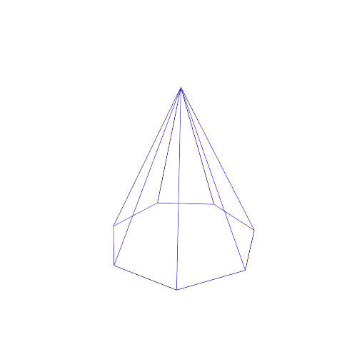
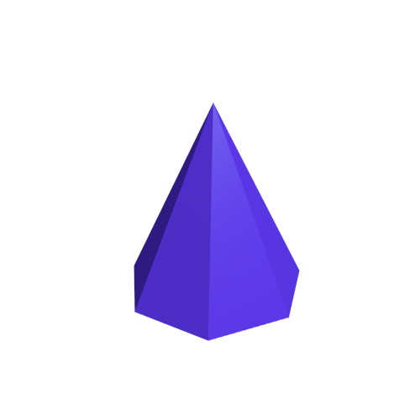
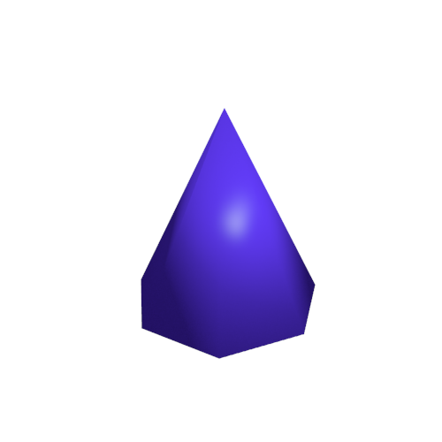
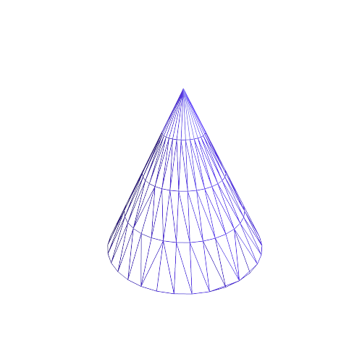
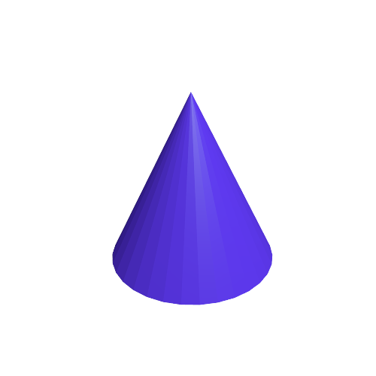
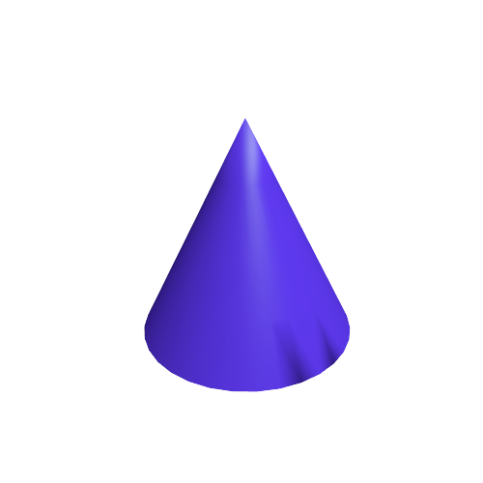
Higher fidelity geometry
Modern games display models with extraordinary geometric detail
How can we represent such detail?
More triangles?
  Yes, but how? And where?

Slide 43
Subdivision surfaces
Recursively subdivide primitives
Adjust vertex positions
Outcome is a smooth, high fidelity surface

Slide 44
Subdivision surfaces – CPU Approach
Planar subdivision using Half Edge data structure
V3
V3
V3
T3
HE3
HE2
V6
V5
V6
V5
T1
T1
T4
T1
T2
V1
V2
V1
V2
V1
V2
HE1
V4
V4
Original
Split All Edges
Triangulate

Slide 45
Subdivision surfaces – CPU Approach
Smoothing step
  Adjust vertex positions to smooth surface
Process
  Pre-smoothing vertex positions are V⁻
  Create a new vertex array, V⁺
  Apply V⁺ = SV⁻ (see slide notes for important details!)
    S, a local “subdivision matrix,” is a coefficient matrix that computes a weighted average at each vertex, based on pre-smoothed locations of neighborhood
    Weighting factors are a function of a valence(vert)
    Half edge data structure useful to traverse neighborhood
Example: Catmull-Clark subdivision surfaces
Notes:
Implementations of subdivision surfaces typically do not apply a global subdivision matrix. A global subdivision matrix, which updates all vertex positions in a single step, is difficult to formulate accurately, in part due to the need to properly handle extraordinary vertices (vertices with a non-standard valence…see references). The global subdivision matrix also makes it more expensive to perform local subdivision refinement, which you might want to apply in a view-dependent level-of-detail application. The reason for the added expense is that a global subdivision matrix would operate on even vertices/edges/faces that are not currently subdivided. Implementations usually smooth the vertices around local neighborhoods, effectively using a local subdivision matrix that is a function of the neighborhood valence. Usually, smoothing is done locally, and in 3 phases: 1) new face vertex positions are computed first (if doing face subdivision, which inserts a new vertex into each face…NOT illustrated in this presentation); 2) new edge vertex positions, from the edge splits illustrated in this presentation, are computed next using appropriate coefficients and positions of the pre-smoothed corner vertices and new face vertex positions; and, 3) finally, the updated positions of the vertices that existed before subdivision are computed using the new face and edge vertex positions, based on the valence of the vertices.
If you are interested in implementing subdivision surfaces, please consider reviewing the references and other literature. There is a wealth of information available on theory and implementation schemes.

Slide 46
Higher fidelity geometry
More triangles? Yes, but…
Large data size can become prohibitive
  CPU to GPU cost
  Cost to transform/animate every vertex
  How can we solve this?

Slide 47
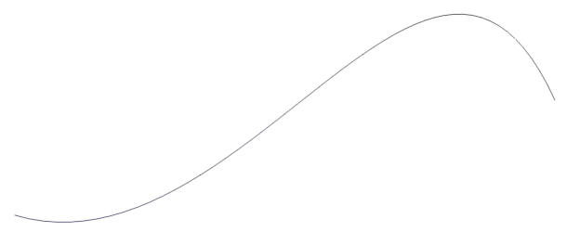
Higher order surfaces on GPU
Continuously smooth
  Evaluate at any resolution
Basic modeling element
  Control point net
GPU tessellation and evaluation
  OpenGL 4/DirectX 11

Slide 48
Rectangular Bicubic Bézier Patch
V13
V9
V14
V10
V5
V15
V6
V11
V1
V2
V7
V16
V12
V3
u
V8
v
V4
Notes:
Note that you can compute a u direction tangent at a parametric patch point (u,v) by taking the u derivative of the P(u,v) equation on this slide. And you can compute the v direction tangent (or bitangent) at the same point by taking the v deriviate of P(u,v). The local surface normal at P(u,v) is the cross product of the tangent and bitangent. Usually you need to normalize these before use.

Slide 49
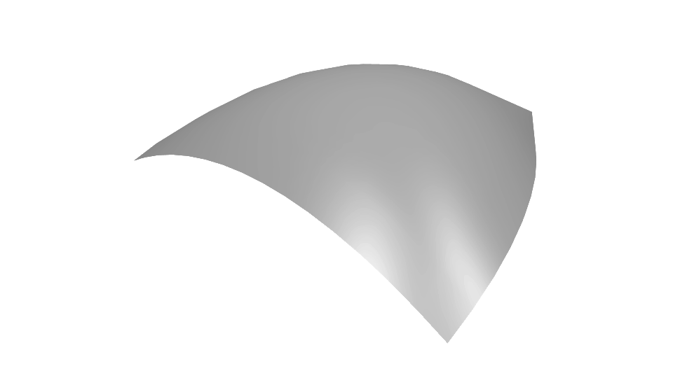
Rendering on the GPU
OpenGL 4 tessellation
  Tessellation pipeline
Evaluate S(u,v)
Vertex Shader
Tessellation Control
(u
Tessellation Evaluation
Fragment
Shader
Tessellation
…
Setup Patch
(u,v)

Slide 50
Use Half Edge to generate patches
Given a closed mesh of tris or quads
  Create a patch per primitive
  Use half edge to extract full 16x16 (for quads) control net using neighbor information

Slide 51
Demo with code

Slide 52
Final Remarks - Topology
Why use topological data structures such as HE?
  Rapid access to complete local neighborhood (1-ring, 2-ring…) of face/vertex/edge
  Elegant, well-defined interface for editing/modifying mesh
  Use of markers supports sophisticated selection modes
  Good support for editing subdivision surfaces

Slide 53
Final Remarks - Topology
Considerations
  Topological data structures typically are not GPU friendly
  Alternatively, could use spatial partition scheme to rapidly modify GPU-friendly vertex/index arrays
    E.g., use spatial hash or Kd-tree to locate faces/vertices/edges for an edit operation
    May need to pack or “defragment” arrays periodically to optimize memory usage, since editing operations may necessarily leave portions of linear arrays unused

Slide 54
Final Remarks – Higher Order Surfaces
Use tessellation sparingly, as it is expensive
Displacement maps over a GPU-tessellated triangle mesh
  Alternative to modeling a large number of higher order patches
  Especially good for games
  Many game engine art pipelines support this approach

Slide 55
References and Resources
These slides
  See http://www.gdcvault.com after GDC
References for meshes, half-edge
  http://www.cs.cornell.edu/courses/cs4620/2010fa/lectures/05meshes.pdf (Shirley & Marschner)
  http://fgiesen.wordpress.com/2012/02/21/half-edge-based-mesh-representations-theory/
    Nice discussion of invariants
    See also the followup: http://fgiesen.wordpress.com/2012/03/24/half-edge-based-mesh-representations-practice/
  http://people.csail.mit.edu/indyk/6.838-old/handouts/lec4.pdf
    Polygon triangulation

Slide 56
References and Resources
References for subdivision surfaces
  Warren, Joe, and Henrik Weimer, Subdivision Methods for Geometric Design, Morgan Kauffman Publishers, 2002
  Zorin, Denis, et al., “Subdivision for Modeling and Animation,” SIGGRAPH 2000 Course Notes, http://www.mrl.nyu.edu/publications/subdiv-course2000/coursenotes00.pdf, 2000
References for OpenGL tessellation
  http://prideout.net/blog/?tag=tessellation
References for robustness issues
  Christer Ericson, Real-time Collision Detection
  Jonathan Shewchuk’s, “Adaptive Precision Floating-Point Arithmetic and Fast Robust Predicates for Computational Geometry”
  John Hobby, “Practical Segment Intersection with Finite Precision Output” (snap rounding)

Slide 57
Questions?

Slide 58
Backup Slides

Slide 59
Manifold Topology
Each edge joins exactly two faces
  Model is said to be watertight
Open edges that join to one face are allowed
Modeling operation consistency rules
  “Invariants”
Non-manifold
Topology
Notes:
This is our focus. Simple models with at most two triangles/polygons touching on common edges.

Slide 60
Backup slides: half edge gotchas

Slide 61
What can go wrong?
Be careful when clipping concave face
  Clipping against a plane can generate multiple loops
  User marker flags to tag start and stop points
  Recursively traverse to find ears to clip

Slide 62
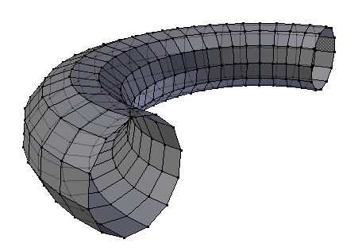
What can go wrong?
Some scenarios produce multiple loops
  Holes in a face
  Requires additional triangulation logic
  Nested loops: auxiliary edge to convert to
  simple polygon
  Multiple un-nested loops: locate and
  triangulate each loop separately
*See speaker notes below slide for an important consideration!
Notes:
NOTE: It is straightforward to triangulate/cover an open loop that is on a plane. Or one that is approximately planar. If the edges on the loop are not all coplanar, then it is trickier. It may be possible to find some projection plane in which to perform the triangulation connectivity (a plane in which the projection of the edge loop is a simple polygon with all the original edges visible), but a different triangulation will result from different project plane choices. Ultimately, the triangles produced will not be coplanar if the edges were not coplanar, of course.

Slide 63
Backup slides: robustness issues

Slide 64
Orientation Inversion
Notes:
This grid is a portion of the representable floating point numbers. These two triangles are defined by corners that are representable points. Points not lying on the intersection of horizontal and vertical grid lines are not representable. Any unrepresentable number is approximated by a representable number.

Slide 65
Orientation Inversion
Notes:
This intersection point is not representable, so the floating point math system will approximate it with the nearest representable number coordinate.

Slide 66
Orientation Inversion

Slide 67
Orientation Inversion

Slide 68
Orientation Inversion
Polygon is no longer simple (it self-intersects) and no longer has a consistent orientation

Slide 69
Cascades of Extraneous Intersections
Notes:
Here, though the floating point grid is not shown, you will see that a single non-representable intersection point can lead to a chain of intersections that aren’t present in the original perfect geometry.

Slide 70
Cascades of Extraneous Intersections

